Slide 1
Branch-and-Bound
Traveling Salesperson Problem

Slide 2
Introduction
The branch-and-bound design strategy is very similar to backtracking in that a state space tree is used to solve a problem.
The differences are that the branch-and-bound method 1) does not limit us to any particular way of traversing the tree, and 2) is used only for optimization problems.
A branch-and-bound algorithm computes a number (bound) at a node to determine whether the node is promising.

Slide 3
Introduction …
The number is a bound on the value of the solution that could be obtained by expanding beyond the node.
If that bound is no better than the value of the best solution found so far, the node is nonpromising. Otherwise, it is promising.
The backtracking algorithm for the 0-1 Knapsack problem is actually a branch-and-bound algorithm.
A backtracking algorithm, however, does not exploit the real advantage of using branch-and-bound.

Slide 4
Introduction …
Besides using the bound to determine whether a node is promising, we can compare the bounds of promising nodes and visit the children of the one with the best bound.
This approach is called best-first search with branch-and-bound pruning. The implementation of this approach is a modification of the breadth-first search with branch-and-bound pruning.

Slide 5
Branch and Bound
An enhancement of backtracking
Applicable to optimization problems
Uses a lower bound for the value of the objective function for each node (partial solution) so as to:
guide the search through state-space
rule out certain branches as “unpromising”

Slide 6
Breadth-first Search
We can implement this search using a queue.
All child nodes are placed in the queue for later processing if they are promising.
Calculate an integer value for each node that represents the maximum possible profit if we pick that node.
If the maximum possible profit is not greater than the best total so far, don’t expand the branch.

Slide 7
Breadth-first Search
The breadth-first search strategy has no advantage over a depth-first search (backtracking).
However, we can improve our search by using our bound to do more than just determine whether a node is promising.

Slide 8
Best-first Search
Best-first search expands the node with the best bounds next.
How would you implement a best-first search?
Depth-first is a stack
Breadth-first is a queue
Best-first is a ???

Slide 9
Types of Traversal
When implementing the branch-and-bound approach there is no restriction on the type of state-space tree traversal used. Backtracking, for example, is a simple type of B&B that uses depth-first search.
A better approach is to check all the nodes reachable from the currently active node (breadth-first) and then to choose the most promising node (best-first) to expand next.
An essential element of B&B is a greedy way to estimate the value of choosing one node over another. This is called the bound or bounding heuristic. It is an underestimate for a minimal search and an overestimate for a maximal search.
When performing a breadth-first traversal, the bound is used only to prune the unpromising nodes from the state-space tree. In a best-first traversal the bound cab also used to order the promising nodes on the live-node list.

Slide 10
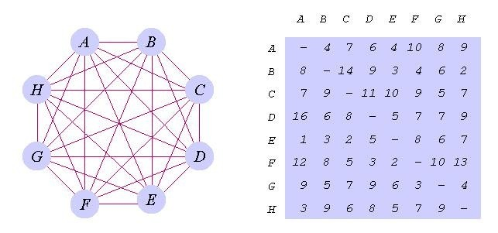
Traveling Salesperson B&B
In the most general case the distances between each pair of cities is a positive value with dist(A,B) /= dist(B,A). In the matrix representation, the main diagonal values are omitted (i.e. dist(A,A) = 0).

Slide 11
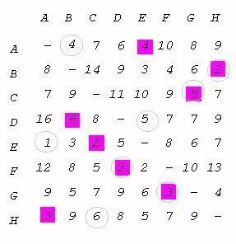
Obtaining an Initial Tour Use the greedy method to find an initial candidate tour. We start with city A (arbitrary) and choose the closest city (in this case E). Moving to the newly chosen city, we always choose the closest city that has not yet been chosen until we return to A.
Our candidate tour is
A-E-C-G-F-D-B-H-A
with a tour length of 28. We know that a minimal tour will be no greater than this.
It is important to understand that the initial candidate tour is not necessarily a minimal tour nor is it unique.
If we start with city E for example, we have,
E-A-B-H-C-G-F-D-E
with a length of 30

Slide 12
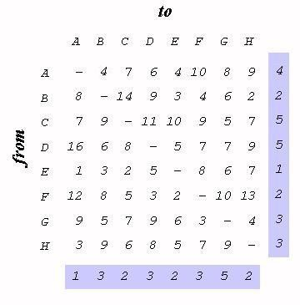
Defining a Bounding Heuristic
Now we must define a bounding heuristic that provides an underestimate of the cost to complete a tour from any node using local information. In this example we choose to use the actual cost to reach a node plus the minimum cost from every remaining node as our bounding heuristic.
h(x) = a(x) + g(x)
a(x) - actual cost to node x
g(x) - minimum cost to complete
Since we know the minimum cost from each node to anywhere we know that the minimal tour cannot be less than 25.

Slide 13
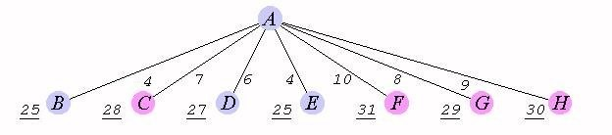
Finding the Minimal Tour
Starting with node A determine the actual cost to each of the other nodes.
Now compute the minimum cost from every other node 25-4=21.
Add the actual cost to a node a(x) to the minimum cost from every other node to determine a lower bound for tours from A through B,C,. . ., H.
4. Since we already have a candidate tour of 28 we can prune all branches with a lower-bound that is ? 28. This leaves B, D and E as the only promising nodes. 5. We continue to expand the promising nodes in a best-first order (E1,B1,,D1).

Slide 14
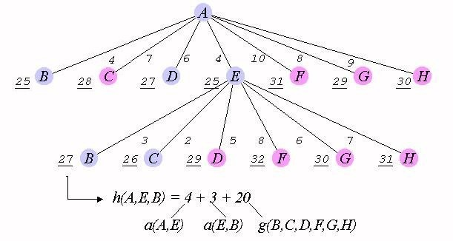
5. We continue to expand the promising nodes in a best-first order (E1,B1,,D1).

Slide 15
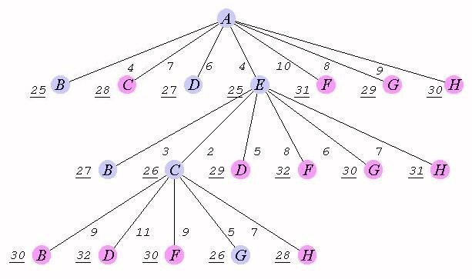
6. We have fully expanded node E so it is removed from our live-node list and we have two new nodes to add to the list. When two nodes have the same bounding values we will choose the one that is closer to the solution. So the order of nodes in our live-node list is (C2,B1,B2,D1).

Slide 16
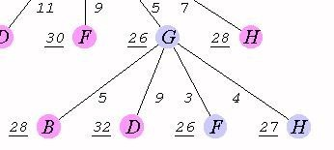
7. We remove node C2 and add node G3 to the live-node list. (G3,B1,B2,D1).

Slide 17
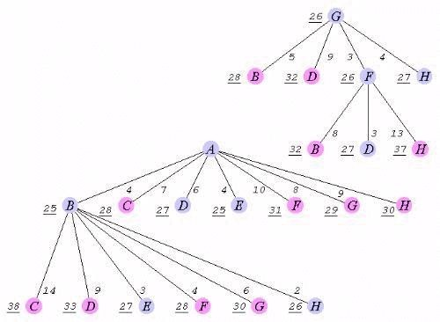
8. Expanding node G gives us two more promising nodes F4 and H4. Our live-node list is now (F4,B1,H4,B2,D1).

Slide 18
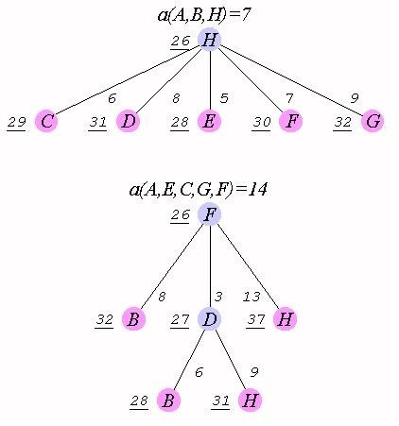
9. A 1st level node has moved to the front of the live-node list. (B1,D5,H4,B2,D1)
10. (H2,D5,H4,B2,D1)
11. (D5,H4,B2,D1)
12. (H4,B2,D1)
13. (B2,D1)
14. (H3,D1)

Slide 19
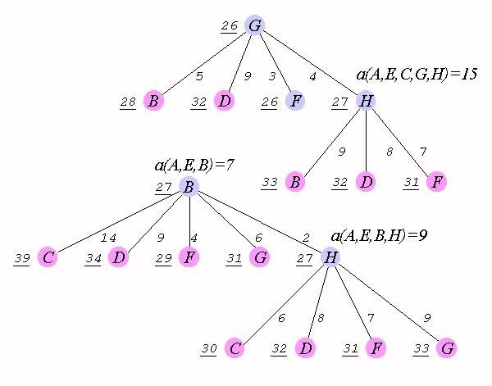
15. (D1)

Slide 20
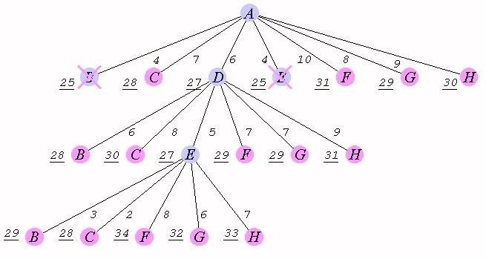
16.We have verified that a minimal tour has length >= 28. Since our candidate tour has a length of 28 we now know that it is a minimal tour, we can use it without further searching of the state-space tree.

Slide 21

Positive integer P₁, P₂, …, P_{n} (profit)
W₁, W₂, …, W_{n} (weight) M (capacity)

n
maximize ∑P_{i} X_{i}
i=1
n
subject to ∑W_{i} X_{i} ≤M
i=1
The problem is modified:
minimize −∑P_{i} X_{i}
i=1
X_{i} = 0 or 1, i =1, …, n.
n
15

Slide 22
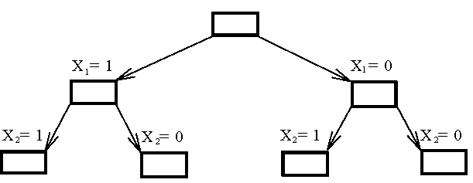
Fig. 6-27 The Branching Mechanism in the Branch-and-Bound Strategy to Solve 0/1 Knapsack Problem.
16

Slide 23

Ans: by quickly finding a feasible solution: starting from the smallest available i, scanning towards the largest i’s until M is exceeded. The upper bound can be calculated.

17

Slide 24
○ E.g. n = 6, M = 34
i | 1 | 2 | 3 | 4 | 5 | 6
P_{i} | 6 | 10 | 4 | 5 | 6 | 4
W_{i} | 10 | 19 | 8 | 10 | 12 | 8
(P_{i}/W_{i} ≥ P_{i+1}/W_{i+1})
X₁ = 1, X₂ = 1, X₃ = 0, X₄ = 0,
○ A feasible solution: X₅ = 0, X₆ = 0
-(P₁+P₂) = -16 (upper bound)
Any solution higher than -16 can not be an optimal solution.
18

Slide 25

Ans: by relaxing our restriction from X_{i} = 0

or 1 ton0 ≤ X_{i} ≤ 1 (knapsack problem)
Let −∑P_{i} X_{i} be an optimal solution for 0/1
i=1
n
knapsack problem and
−∑P_{i} X′_{i}
i=1
be an optimal
n
solution for knapsack problem. Let Y= −∑P_{i} X_{i} ,
i=1
n
Y’ =
−∑P_{i} X′_{i} .
i=1
⇒Y’ ≤Y

Slide 26

We can use the greedy method to find an optimal solution for knapsack problem.
For example, for the state of X₁=1 and X₂=1, we have


X₁ = 1, X₂ =1, X₃ = (34-6-10)/8=5/8, X₄ = 0, X₅ = 0, X₆ =0
-(P₁+P₂+5/8P₃) = -18.5 (lower bound)
-18 is our lower bound. (only consider integers)
20

Slide 27

By the best-first search scheme


That is, by expanding the node with the best lower bound. If two nodes have the same lower bounds, expand the node with the lower upper bound.
21

Slide 28

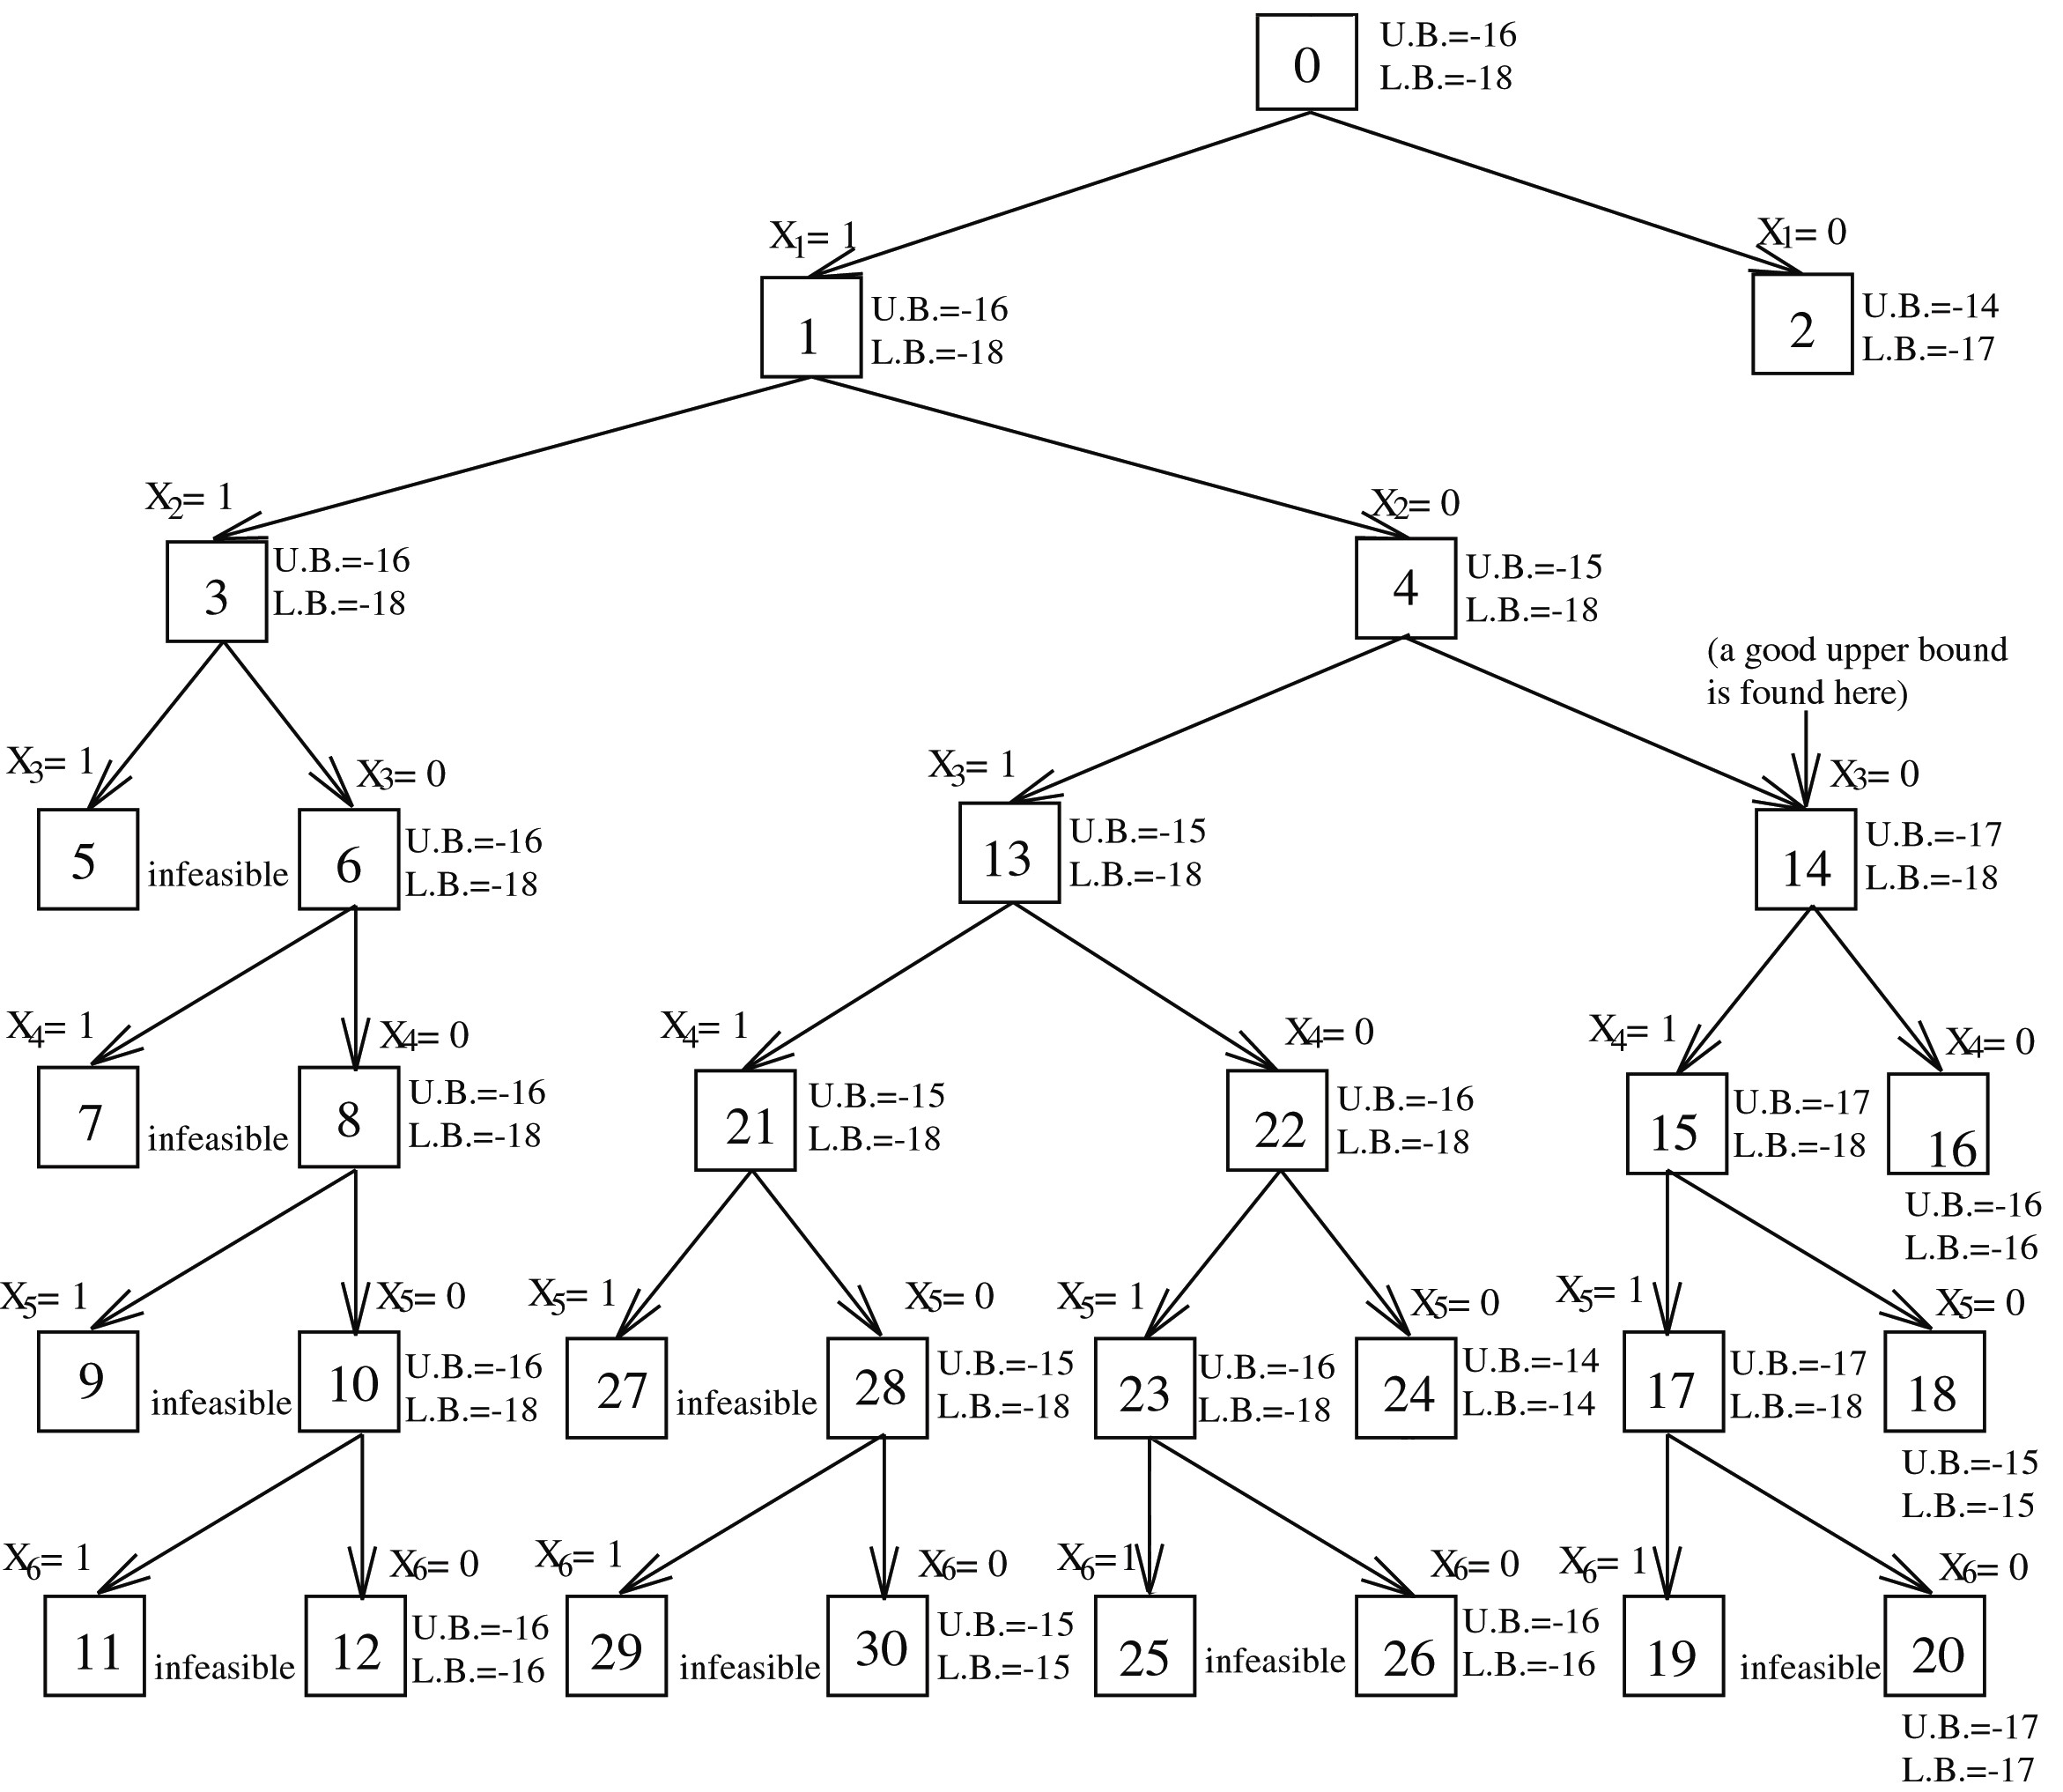
0/1 Knapsack Problem Solved by Branch-and-Bound Strategy
22

Slide 29

Node 2 is terminated because its lower bound is equal to the upper bound of node 14.
Nodes 16, 18 and others are terminated because the local lower bound is equal to the local upper bound.
(lower bound ≤ optimal solution ≤ upper bound

Slide 30
Thank You

